Slide 1
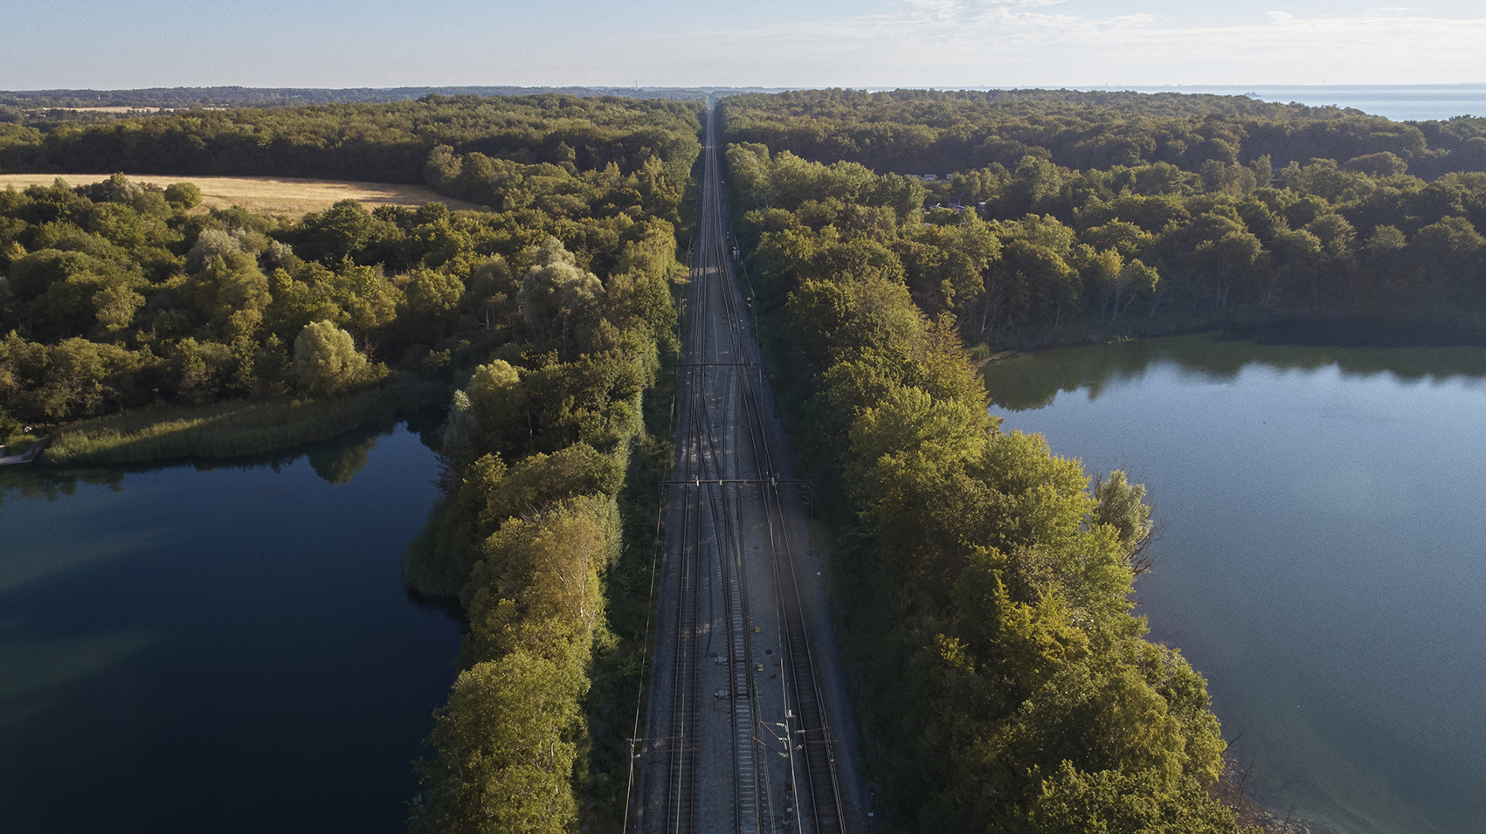

An attractive and sustainable railway
BANEDANMARK’S STRATEGY

Slide 2


STRATEGY An attractive and sustainable railway
2/13
Towards an attractive and sustainable
railway of the future
Everyday, thousands of passengers commute to work, go on holiday or meet friends and family using the network Banedanmark provides in Denmark. We also transport thousands of tons of freight across the railway network.
We are building a completely new attractive and sustainable railway for new modern electric trains, while we keep the existing railway running. We maintain and upgrade existing sections while building a new train corridor to Europe and rolling out new signals and electrify the railway.
The attractive, sustainable railway of the future will enable trains to run faster, closer and smarter for the customers’ benefit. Congestion will be reduced. Electric trains are better for the climate and the environment. We will do our utmost to show consideration towards nature and to strengthen the biodiversity lineside.

Slide 3




STRATEGY An attractive and sustainable railway
3/13
The four most important challenges on the journey towards an attractive and sustainable railway
An outdated and worn infrastructure
Punctuality
Railway projects are often delayed and exceed budget
Exercising public authority

Slide 4

4/13
Our key areas of focus : Punctuality, Projects and Accountability
To deliver a sustainable and attractive railway we must focus on our key areas: punctuality, projects and accountability:
Many people are involved in the operation and building of the railway – Everybody makes a considerable contribution
Attaining punctuality is dependant on the cooperation between the divisions at Banedanmark that control the trains on the railway, maintain the railway and rollout of new signalling systems etc. All divisions and support functions contribute to our construction projects and programmes.
Working to high professional standards, we need to cooperate closely with the Danish Transport Authority, contractors, consultants and other stakeholders and ensure proper communication and administration towards citizens, municipalities and other stakeholders and clients of the railway
There are many cogs in this large machine. It is a huge challenge to get all the cogs to run as smoothly as possible and it has not always succeeded
We must master the complexity, cooperate internally and externally. Therefore, we will introduce coherent objectives and visual management boards throughout the organization
We emphasize accountability towards the society we are part of by respecting climate, nature and the environment, by developing smarter solutions for the railway’s clients, suppliers, conforming with regulations and exercise good public administration

Slide 5

STRATEGY An attractive and sustainable railway
5/13
Well on track
Punctuality: We have built a thorough data infrastructure and models for analysis, like the machine learning model and a solid organization. We have also improved the maintenance of the railway in an intelligent manner, leading to improved punctuality
Project and programme management: We have improved management of the Signalling and Electrification Programmes, as well as, the large construction and renewal projects
Accountability and management: We have engaged in creating a common culture and initiatives supporting accountability and compliance with regulations. We focus on good leadership with our new leadership model

Slide 6



Banedanmark’s strategy: An attractive and sustainable railway
7/13
VISION (where are we going) We develop and build an attractive, sustainable, safe and efficient railway
MISSION (what does it take) We deliver on our key areas: Punctuality, Projects and Accountability
PUNCTUALITY
PROJECTS
ACCOUNTABILITY
Primary objective
We will deliver prime punctuality to the clients today and tomorrow as well as targeted traffic information in case of deviations
Primary objective
We will build the railway infrastructure of the future by delivering construction projects on time, at agreed cost and quality
Primary objective
We will ensure accountability in our conduct both regarding public authority, timely business development and sustainability
Strategic objectives
Deliver on the annually established passenger punctuality targets
Deliver robust timetables
Deliver immediate as well as long-term improvement initiatives to solve punctuality challenges
Deliver satisfying traffic information to customers
Strategic objectives
Govern SP and EP to success in order for the trains of the future to roll in to Aarhus and Aalborg stations in 2026 and to Fehmarn Belt in 2029
Establish a ‘project factory’ enabling Banedanmark to deliver projects at agreed time, cost and quality
Strategic objectives
Ensure compliance with regulations according to public authority, railway safety and cyber security
Deliver initiatives according to plan for business development
Provide a more sustainable railway

Slide 7
STRATEGY An attractive and sustainable railway
The organization supporting the strategy
Organization
Management fora
Board of Management
CEO
Hakon Iversen
Management Secretariat
Søren Stentoft Herping
Project Forum
(Board of Management)
Punctuality Forum
(Board of Management)
Quality & Safety
Martin Harrow
Preparatory Project Forum
Internal value stream board
Punctuality forum with DSB
Projects
Accountability
Punctuality
Ressources
Anne Hougaard Olesen
Infrastructure
Claus Hincke
Construction
Peter Jonasson
Traffic
Peter Svendsen
Strategic initiatives

Slide 8

STRATEGY An attractive and sustainable railway
How we create the strategic changes together
Visual management board and objective management for punctuality and projects
Management
- Supporting the strategy implementation, specifically visual board management
Insourcing/outsourcing
- Supporting the implementation of insourcing in the Construction area and outsourcing in the maintenance area to ensure proper planning and management competences
----------------------------------------------------------------------------------------------------------------------------------------------------
The strategic initiatives remove barriers for punctuality and projects and implement accountability
Strategic initiative
Strategic initiative
Strategic initiative
Strategic initiative
Strategic initiative
Strategic initiative

